Slide 1

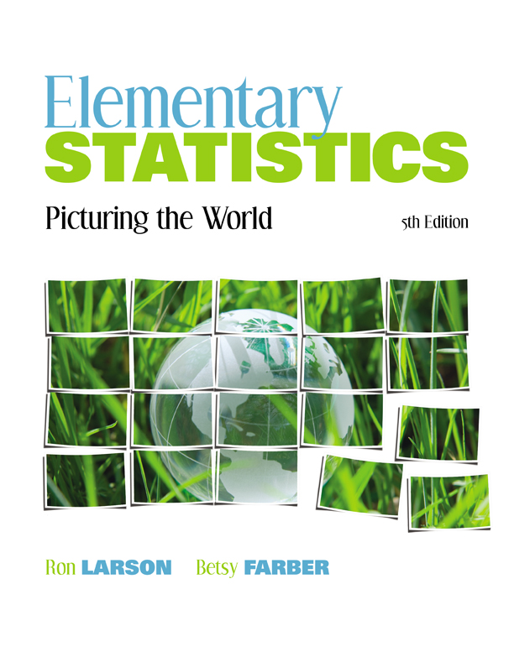

Chapter
4
Discrete Probability Distributions
© 2012 Pearson Education, Inc.
All rights reserved.
<number> of 63

Slide 2
Chapter Outline
4.1 Probability Distributions
© 2012 Pearson Education, Inc. All rights reserved.
<number> of 63

Slide 3
Section 4.1
Probability Distributions
© 2012 Pearson Education, Inc. All rights reserved.
<number> of 63

Slide 4
Section 4.1 Objectives
Distinguish between discrete random variables and continuous random variables
Construct a discrete probability distribution and its graph
Determine if a distribution is a probability distribution
Find the mean, variance, and standard deviation of a discrete probability distribution
Find the expected value of a discrete probability distribution
© 2012 Pearson Education, Inc. All rights reserved.
<number> of 63

Slide 5
Random Variables
Random Variable
Represents a numerical value associated with each outcome of a probability distribution.
Denoted by x
Examples
  x = Number of sales calls a salesperson makes in one day.
  x = Hours spent on sales calls in one day.
© 2012 Pearson Education, Inc. All rights reserved.
<number> of 63

Slide 6
Random Variables
Discrete Random Variable
Has a finite or countable number of possible outcomes that can be listed.
Example
  x = Number of sales calls a salesperson makes in one day.
x
0
1
2
3
4
5
© 2012 Pearson Education, Inc. All rights reserved.
<number> of 63

Slide 7
Random Variables
Continuous Random Variable
Has an uncountable number of possible outcomes, represented by an interval on the number line.
Example
  x = Hours spent on sales calls in one day.
x
0
1
2
3
…
24
© 2012 Pearson Education, Inc. All rights reserved.
<number> of 63

Slide 8
Example: Random Variables
Decide whether the random variable x is discrete or continuous.
xx = The number of Fortune 500 companies that lost money in the previous year.
Solution:
Discrete random variable (The number of companies that lost money in the previous year can be counted.)
{0, 1, 2, 3, …, 500}
© 2012 Pearson Education, Inc. All rights reserved.
<number> of 63

Slide 9

Example: Random Variables
Decide whether the random variable x is discrete or continuous.
xx = The volume of gasoline in a 21-gallon tank.
Solution:
Continuous random variable (The amount of gasoline in the tank can be any volume between 0 gallons and 21 gallons.)
© 2012 Pearson Education, Inc. All rights reserved.
<number> of 63

Slide 10
Discrete Probability Distributions
Discrete probability distribution
Lists each possible value the random variable can assume, together with its probability.
Must satisfy the following conditions:
In Words In Symbols
The probability of each value of the discrete random variable is between 0 and 1, inclusive.
The sum of all the probabilities is 1.
0 ≤ P (x) ≤ 1
ΣP (x) = 1
© 2012 Pearson Education, Inc. All rights reserved.
<number> of 63

Slide 11
Constructing a Discrete Probability Distribution
Let x be a discrete random variable with possible outcomes x₁, x₂, … , x_{n}.
Make a frequency distribution for the possible outcomes.
Find the sum of the frequencies.
Find the probability of each possible outcome by dividing its frequency by the sum of the frequencies.
Check that each probability is between 0 and 1, inclusive, and that the sum of all probabilities is 1.
© 2012 Pearson Education, Inc. All rights reserved.
<number> of 63

Slide 12
Example: Constructing a Discrete Probability Distribution
An industrial psychologist administered a personality inventory test for passive-aggressive traits to 150 employees. Individuals were given a score from 1 to 5, where 1 was extremely passive and 5 extremely
aggressive. A score of 3 indicated neither trait. Construct a probability distribution for the random variable x. Then graph the distribution using a histogram.
Score, x | Frequency, f
1 | 24
2 | 33
3 | 42
4 | 30
5 | 21
© 2012 Pearson Education, Inc. All rights reserved.
<number> of 63

Slide 13
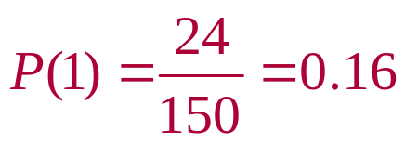
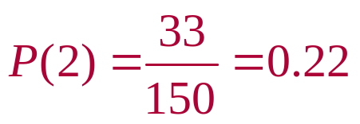
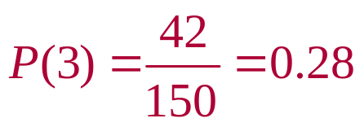
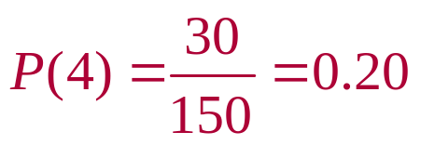
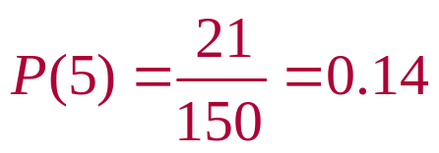
Solution: Constructing a Discrete Probability Distribution
Divide the frequency of each score by the total number of individuals in the study to find the probability for each value of the random variable.
Discrete probability distribution:
x | 1 | 2 | 3 | 4 | 5
P(x) | 0.16 | 0.22 | 0.28 | 0.20 | 0.14
© 2012 Pearson Education, Inc. All rights reserved.
<number> of 63

Slide 14
Solution: Constructing a Discrete Probability Distribution
x | 1 | 2 | 3 | 4 | 5
P(x) | 0.16 | 0.22 | 0.28 | 0.20 | 0.14
This is a valid discrete probability distribution since
Each probability is between 0 and 1, inclusive,
0 ≤ P(x) ≤ 1.
The sum of the probabilities equals 1,
ΣP(x) = 0.16 + 0.22 + 0.28 + 0.20 + 0.14 = 1.
© 2012 Pearson Education, Inc. All rights reserved.
<number> of 63

Slide 15
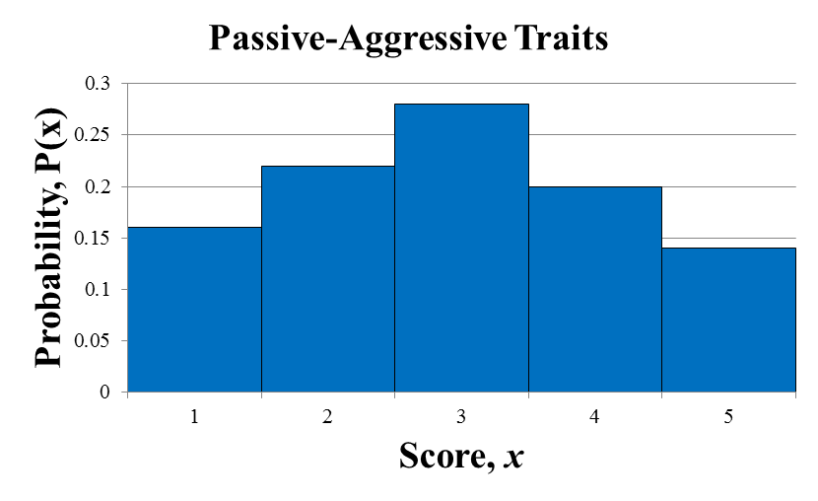
Solution: Constructing a Discrete Probability Distribution
Histogram
Because the width of each bar is one, the area of each bar is equal to the probability of a particular outcome.
© 2012 Pearson Education, Inc. All rights reserved.
<number> of 63

Slide 16
Mean
Mean of a discrete probability distribution
μ = ΣxP(x)
Each value of x is multiplied by its corresponding probability and the products are added.
© 2012 Pearson Education, Inc. All rights reserved.
<number> of 63

Slide 17
Example: Finding the Mean
The probability distribution for the personality inventory test for passive-aggressive traits is given. Find the mean score.
Solution:
x | P(x) | xP(x)
1 | 0.16 | 1(0.16) = 0.16
2 | 0.22 | 2(0.22) = 0.44
3 | 0.28 | 3(0.28) = 0.84
4 | 0.20 | 4(0.20) = 0.80
5 | 0.14 | 5(0.14) = 0.70
μ = ΣxP(x) = 2.94
© 2012 Pearson Education, Inc. All rights reserved.
<number> of 63

Slide 18
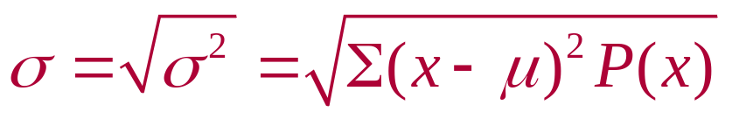
Variance and Standard Deviation
Variance of a discrete probability distribution
σ² = Σ(x – μ)²P(x)
Standard deviation of a discrete probability distribution
© 2012 Pearson Education, Inc. All rights reserved.
<number> of 63

Slide 19
Example: Finding the Variance and Standard Deviation
The probability distribution for the personality inventory test for passive-aggressive traits is given. Find the variance and standard deviation. ( μ = 2.94)
x | P(x)
1 | 0.16
2 | 0.22
3 | 0.28
4 | 0.20
5 | 0.14
© 2012 Pearson Education, Inc. All rights reserved.
<number> of 63

Slide 20
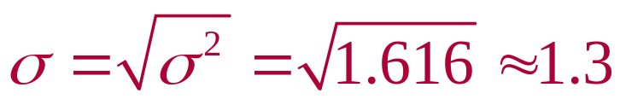
Solution: Finding the Variance and Standard Deviation
Recall μ = 2.94
x | P(x) | x – μ | (x – μ)² | (x – μ)²P(x)
1 | 0.16 | 1 – 2.94 = –1.94 | (–1.94)² ≈ 3.764 | 3.764(0.16) ≈ 0.602
2 | 0.22 | 2 – 2.94 = –0.94 | (–0.94)² ≈ 0.884 | 0.884(0.22) ≈ 0.194
3 | 0.28 | 3 – 2.94 = 0.06 | (0.06)² ≈ 0.004 | 0.004(0.28) ≈ 0.001
4 | 0.20 | 4 – 2.94 = 1.06 | (1.06)² ≈ 1.124 | 1.124(0.20) ≈ 0.225
5 | 0.14 | 5 – 2.94 = 2.06 | (2.06)² ≈ 4.244 | 4.244(0.14) ≈ 0.594
Variance:
σ² = Σ(x – μ)²P(x) = 1.616
Standard Deviation:
© 2012 Pearson Education, Inc. All rights reserved.
<number> of 63

Slide 21
Expected Value
Expected value of a discrete random variable
Equal to the mean of the random variable.
E(x) = μ = ΣxP(x)
© 2012 Pearson Education, Inc. All rights reserved.
<number> of 63

Slide 22

Example: Finding an Expected Value
At a raffle, 1500 tickets are sold at $2 each for four prizes of $500, $250, $150, and $75. You buy one ticket. What is the expected value of your gain?
© 2012 Pearson Education, Inc. All rights reserved.
<number> of 63

Slide 23
Solution: Finding an Expected Value
To find the gain for each prize, subtract
the price of the ticket from the prize:
  Your gain for the $500 prize is $500 – $2 = $498
  Your gain for the $250 prize is $250 – $2 = $248
  Your gain for the $150 prize is $150 – $2 = $148
  Your gain for the $75 prize is $75 – $2 = $73
If you do not win a prize, your gain is $0 – $2 = –$2
© 2012 Pearson Education, Inc. All rights reserved.
<number> of 63

Slide 24
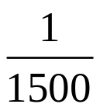
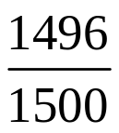
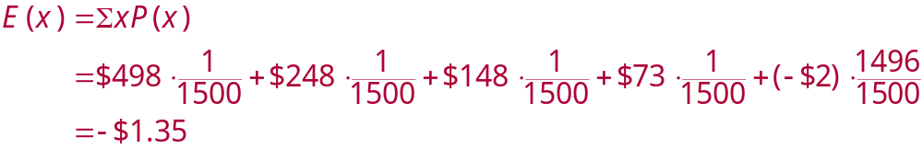
Solution: Finding an Expected Value
Probability distribution for the possible gains (outcomes)
Gain, x | $498 | $248 | $148 | $73 | –$2
P(x)
You can expect to lose an average of $1.35 for each ticket you buy.
© 2012 Pearson Education, Inc. All rights reserved.
<number> of 63

Slide 25
Section 4.1 Summary
Distinguished between discrete random variables and continuous random variables
Constructed a discrete probability distribution and its graph
Determined if a distribution is a probability distribution
Found the mean, variance, and standard deviation of a discrete probability distribution
Found the expected value of a discrete probability distribution
© 2012 Pearson Education, Inc. All rights reserved.
<number> of 63

